Slide 1
2025 ASEAN IPA ADR-Mediation and Arbitration forIP
Speaker:WANG Fang, Deputy Secretary-general of CCPIT Mediation Center

Slide 2
一、知识产权调解政策、法律法规和司法解释
1.Intellectual Property Mediation Policies，Laws & Regulations and Judicial Interpretations
二、知识产权调解与其他纠纷调解的多方面区别
2.Key Differences Between Intellectual Property Dispute Mediation and Other Types of Dispute Mediation
三、四种调解形式的区别和适用范围
3. Differences and Applicable Scope of the Four Types of Mediation in China
四、运用调解解决国际知识产权纠纷的步骤
4.Steps for Resolving International Intellectual Property (IP) Disputes through Mediation
五、知识产权纠纷调解工作进展与成效
5.Progresses and Achievements of intellectual property dispute mediation work
目录
CONTENTS

Slide 3
知识产权调解政策、法律法规和司法解释
Intellectual Property Mediation Policies,Laws & Regulations and Judicial Interpretations

Slide 4
国家政策
National Policy
《关于加强知识产权纠纷调解工作的意见》：提出到 2025 年，知识产权纠纷调解工作基本覆盖知识产权纠纷易发多发的重点区域和行业领域，建立组织健全、制度完善、规范高效的知识产权纠纷调解工作体系。形成多种调解优势互补、有机衔接、协调联动的大调解工作格局。
Opinions on Strengthening Mediation in Disputes over Intellectual Property Rights outlines the goal of covering key areas and industries where intellectual property disputes are frequent by 2025, establishing an organized, well-structured, and efficient mediation system for intellectual property disputes. The plan aims to form a large-scale mediation framework that complements various mediation advantages, ensures smooth coordination, and fosters organic connections.

Slide 5
国家政策
National Policy
《知识产权强国建设纲要（2021-2035 年）》：提出要发挥专利侵权纠纷行政裁决制度作用，加大行政裁决执行力度等，为知识产权调解等工作的开展提供了宏观指导和方向指引。
The Outline for Building an Intellectual Property Powerhouse (2021-2035): emphasizes the role of administrative adjudication in patent infringement disputes and advocates for enhanced enforcement of administrative adjudication. It provides macro guidance and direction for the development of intellectual property mediation and related work.
《“十四五” 国家知识产权保护和运用规划》：提出要加强知识产权纠纷多元化解机制建设，完善行政调解等工作。
The 14th Five-Year National Plan for Intellectual Property Protection and Utilization: proposes strengthening the development of diversified mechanisms for resolving intellectual property disputes and improving administrative mediation.

Slide 6
法律法规&司法解释
Laws and Regulations & Judicial Interpretations
《中华人民共和国民事诉讼法》：为知识产权纠纷的司法调解等提供了基本的程序法依据。 《中华人民共和国专利法》《中华人民共和国专利法实施细则》《中华人民共和国商标法》《中华人民共和国著作权法》《中华人民共和国反不正当竞争法》 《最高人民法院关于审理著作权民事纠纷案件适用法律若干问题的解释》 《最高人民法院关于审理专利纠纷案件适用法律问题的若干规定》 《最高人民法院关于审理商标民事纠纷案件适用法律若干问题的解释》
Civil Procedure Law of the People‘s Republic of China provides the basic procedural legal basis for judicial mediation in intellectual property disputes. Patent Law of the People’s Republic of China, the Regulations for the Implementation of the Patent Law of the People‘s Republic of China， Trademark Law of the People’s Republic of China， Copyright Law of the People‘s Republic of China， Anti-Unfair Competition Law of the People’s Republic of China Interpretation of the Supreme People's Court Concerning the Application of Laws in the Trial of Civil Disputes over Copyright ， Several Provisions of the Supreme People's Court on Issues concerning the Application of Law in the Trial of Cases Involving Patent Disputes, Interpretation of the Supreme People's Court Concerning the Application of Laws in the Trial of Cases of Civil Disputes Arising from Trademarks

Slide 7
知识产权调解和其他纠纷调解间的多方面区别Key Differences Between Intellectual Property Dispute Mediation and Other Types of Dispute Mediation

Slide 8
调解对象与范围 Differences in Scope and Subject Matter
知识产权调解
Intellectual Property Mediation
其他纠纷调解
Other Dispute Mediation
主要针对与知识产权有关的合同纠纷、权属和侵权纠纷，以及与其有关的竞争纠纷等，涉及著作权、商标权、专利权、集成电路布图设计专有权、植物新品种权、地理标志权、网络域名权以及商业秘密等领域。
It primarily focuses on contract disputes, ownership disputes, and infringement disputes related to intellectual property, as well as competition disputes associated with them. The scope includes copyright, trademark rights, patent rights, integrated circuit layout design rights, plant variety rights, geographical indication rights, domain name rights, and trade secrets.
涵盖范围更为广泛，包括但不限于婚姻家庭纠纷、邻里纠纷、劳动纠纷、合同纠纷（非知识产权类）、消费纠纷等。
The scope is broader and includes, but is not limited to, marital and family disputes, neighborhood disputes, labor disputes, contract disputes (non-IP related), and consumer disputes.

Slide 9
专业性要求 Professional Requirements
知识产权调解
Intellectual Property Mediation
其他纠纷调解
Other Dispute Mediation
知识产权本身具有很强的专业性和技术性，如专利纠纷可能涉及复杂的技术问题，需要调解员具备深厚的知识产权法律知识，还需了解相关技术领域的专业知识，常需专业的知识产权律师、专利代理人等担任调解员。
Intellectual property itself is highly specialized and technical. For example, patent disputes may involve complex technical issues, requiring mediators to have a solid understanding of intellectual property law and knowledge in the relevant technical field. Therefore, it often requires professional intellectual property lawyers, patent agents, or other specialists to serve as mediators.
虽然也需要调解员具备一定的法律知识和调解技巧，但对专业技术知识的要求相对较低。
While mediators in other disputes also need a certain level of legal knowledge and mediation skills, the demand for specialized technical knowledge is relatively lower.

Slide 10
涉密性程度 Confidentiality Requirements
知识产权调解
Intellectual Property Mediation
其他纠纷调解
Other Dispute Mediation
知识产权纠纷中的专利技术、商业秘密等往往涉及当事人不愿公开的技术细节、经营策略等核心信息，保密性要求极高，调解过程中需采取严格的保密措施，防止信息泄露。
Intellectual property disputes, such as patent technology and trade secrets, often involve core information that parties do not wish to disclose, including technical details and business strategies. The confidentiality requirements are extremely high, and strict confidentiality measures must be implemented during the mediation process to prevent information leakage.
虽然部分纠纷也可能涉及当事人的隐私或商业秘密，但从整体上看，涉密性不像知识产权调解那样普遍和突出。
While some disputes may also involve the parties' privacy or trade secrets, overall, the level of confidentiality is not as widespread or prominent as in intellectual property mediation.

Slide 11
利益平衡的难度 Difficulty of Balancing Interests
知识产权调解
Intellectual Property Mediation
其他纠纷调解
Other Dispute Mediation
需要在保护知识产权权利人的合法权益与促进知识传播、技术创新和社会公共利益之间寻求平衡。如在著作权调解中，既要考虑作者的权益，也要考虑作品合理使用对社会文化传播的意义。
It requires balancing the protection of the legitimate rights of intellectual property holders with the promotion of knowledge dissemination, technological innovation, and public interests. For example, in copyright mediation, it is necessary to consider the rights of the author while also taking into account the significance of fair use for the cultural exchange in society.
通常主要是在纠纷双方当事人之间进行利益平衡，相对而言，较少涉及到广泛的社会公共利益等多方面的平衡问题。
Typically, the focus is on balancing the interests between the disputing parties. Compared to intellectual property mediation, there is generally less involvement with broader societal public interests or multiple aspects of balance.

Slide 12
调解结果的影响 Scope of the Impact of Mediation Outcomes
知识产权调解
Intellectual Property Mediation
其他纠纷调解
Other Dispute Mediation
调解结果不仅对当事人双方有影响，还可能对整个行业的技术发展、市场竞争格局等产生一定的影响。如一个重要专利侵权纠纷的调解结果，可能会影响该技术领域的发展方向和市场竞争态势。
The outcome of IP mediation not only affects the disputing parties but can also have a significant impact on the broader industry, including technological development, market competition, and innovation dynamics. For example, the resolution of an important patent infringement dispute may influence the direction of technological advancements and alter the competitive landscape within that field.
一般主要对纠纷当事人双方产生直接影响，对行业和社会整体的影响相对较为局限。
Generally, the impact is more limited, primarily affecting the disputing parties directly. The overall influence on the industry or society is more constrained compared to intellectual property mediation.

Slide 13
国际性因素 International Factors
知识产权调解
Intellectual Property Mediation
其他纠纷调解
Other Dispute Mediation
在经济全球化背景下，知识产权纠纷的国际性和跨国性越来越明显，跨国知识产权纠纷调解需要考虑不同国家的法律制度、文化差异、商业规则等因素，还可能涉及国际公约、国际仲裁规则等。
In the context of economic globalization, the international and cross-border nature of intellectual property disputes has become increasingly prominent. Mediation of cross-border IP disputes requires consideration of factors such as different national legal systems, cultural differences, and business practices. It may also involve international conventions, international arbitration rules, and other global frameworks, making it more complex in terms of coordination and resolution.
虽然也存在涉外的婚姻家庭纠纷、合同纠纷等，但从总体数量和复杂程度上，国际性因素对调解的影响相对小于知识产权调解。
While there are also disputes involving foreign-related marriage and family issues, as well as international contract disputes, the overall impact of international factors on mediation is relatively lower compared to intellectual property mediation, both in terms of quantity and complexity.

Slide 14
四种调解形式的区别和适用范围
Differences and Applicable Scope of the Four Types of Mediation in China

Slide 15
司法调解 Judicial Mediation
与其他调解的区别
Distinctions from other types of mediation
适用范围
Applicable scope
由人民法院主持，具有严格的程序规范，调解协议经法院确认后具有与判决书同等的法律效力，可直接申请强制执行。
Judicial mediation is conducted by the people's courts, following strict procedural regulations. A mediation agreement confirmed by the court has the same legal effect as a court judgment and can be directly enforced.
适用于民事案件、刑事自诉案件以及刑事附带民事诉讼案件等。婚姻家庭纠纷、继承纠纷、劳务合同纠纷、交通事故和工伤事故引起的权利义务较为明确的损害赔偿纠纷等一般会先进行调解。
It applies to civil cases, private criminal prosecution cases, and criminal cases with attached civil claims. Disputes related to marriage and family matters, inheritance, labor contracts, traffic accidents, work-related injuries, and other cases involving clear rights and obligations for damage compensation are generally mediated first.

Slide 16
行政调解 Administrative Mediation
与其他调解的区别
Distinctions from other types of mediation
适用范围
Applicable scope
由国家行政机关主持，调解主体具有较强的专业性，调解结果不具有强制执行力，但在行政机关职权范围内具有一定的行政约束力。
Administrative mediation is conducted by government administrative agencies. The mediating body possesses a high degree of professionalism, and while the mediation result does not have binding enforcement power, it carries a certain degree of administrative authority within the scope of the agency's powers.
用于解决与行政管理相关的民事纠纷，以及行政机关与公民、法人或其他组织之间的行政争议，涉及交通事故、医疗卫生、消费者权益保护、土地承包和环境污染等领域，细分为行政自由裁量权、行政裁决、行政合同等多个方面。
It is used to resolve civil disputes related to administrative management, as well as administrative disputes between government agencies and individuals, legal entities, or other organizations. It covers areas such as traffic accidents, healthcare, consumer rights protection, land contracting, and environmental pollution, and it includes various aspects such as administrative discretion, administrative adjudication, and administrative contracts.

Slide 17
仲裁调解/商事调解 Arbitral Mediation/Commercial Mediation
与其他调解的区别
Distinctions from other types of mediation
适用范围
Applicable scope
在仲裁庭/调解员主持下进行，基于当事人事先或事后达成的仲裁协议/调解协议，调解成功后制作的仲裁调解书与仲裁裁决书具有同等法律效力，一方不履行可申请法院强制执行。
This type of mediation is conducted under the supervision of an arbitration tribunal/with the assistance of a mediator, based on an arbitration /mediation agreement reached by the parties either before or after the dispute arises. If mediation is successful, an arbitral mediation statement is issued, which has the same legal effect as an arbitral award. If one party fails to comply, the other party can apply to the court for enforcement.
主要适用于平等主体的公民、法人和其他组织之间发生的合同纠纷和其他财产权益纠纷，如合同纠纷、知识产权纠纷等。
It is mainly used for contract disputes and other property-related disputes between individuals, legal entities, and organizations that are equal parties, such as contract disputes and intellectual property disputes.

Slide 18
人民调解 People’s Mediation/Community Mediation
与其他调解的区别
Distinctions from other types of mediation
适用范围
Applicable scope
由村委会、居委会等基层组织设立的人民调解委员会主持，具有民间性、群众性和自治性，调解程序简便灵活，不收取费用，达成的调解协议一般不具有强制执行力，但经司法确认后具有强制执行力。
People’s mediation is conducted by people's mediation committees established by village committees, neighborhood committees, and other grassroots organizations. It is characterized by its informal, community-based, and self-governing nature. The mediation process is simple and flexible, and no fees are charged. The mediation agreement generally does not have enforcement power, but if confirmed by the court, it becomes legally binding and enforceable.
可受理包括各类民事纠纷、未违反治安管理条例或未构成犯罪的民事违法纠纷、违反社会公德和公序良俗引起的纠纷、轻微刑事案件引起的纠纷以及医患、劳动、物业、土地、拆迁等相关纠纷。
People’s mediation can handle various civil disputes, including those that do not violate public security regulations or constitute criminal offenses, disputes related to social ethics and public morality, minor criminal cases, and conflicts in areas such as healthcare, labor, property management, land use, and housing demolition.

Slide 19
运用调解解决国际知识产权纠纷的步骤
Steps for Resolving International Intellectual Property (IP) Disputes through Mediation

Slide 20
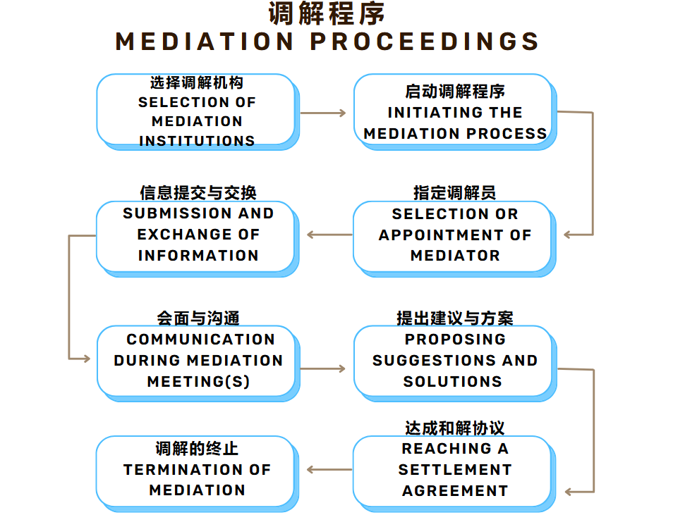

Slide 21
知识产权纠纷调解工作进展与成效
Progresses and Achievements of intellectual property dispute mediation work

Slide 22
Work Progress and Achievements
知识产权纠纷“大调解”工作格局基本形成。各级知识产权管理部门、人民法院、司法行政机关密切配合，积极建立政府引导、社会参与、上下联动、衔接顺畅的知识产权纠纷调解工作机制。截至2023年底，全国知识产权系统指导管理的知识产权纠纷调解组织达1944家，较2022年增加705家。上述知识产权纠纷调解组织2023年受理知识产权纠纷调解案件13.5万件，充分发挥了多渠道解纷作用。2023年，国家知识产权局会同最高人民法院，首次评选发布10条知识产权纠纷多元调解典型经验做法和10个案例，发挥经验示范和专业指导作用。加强业务培训，开展在线公益培训8期，1.2万人次调解员参训。
A “big mediation” framework for intellectual property disputes has basically taken shape. Intellectual property management departments, people’s courts, and judicial administrative organs at all levels closely cooperate to actively establish a mediation mechanism for intellectual property disputes that is guided by the government, participated by society, linked all levels, and smooth in connection. As of the end of 2023, there were 1,944 intellectual property dispute mediation organizations guided and managed by the national intellectual property system, an increase of 705 from 2022.The above-mentioned intellectual property dispute mediation organizations accepted 135,000 cases of intellectual property dispute mediation in 2023, giving full play to the role of multi-channel dispute resolution. In 2023, the State Intellectual Property Office, in conjunction with the Supreme People 's Court, for the first time selected and issued 10 typical experience practices and 10 cases of multi-mediation of intellectual property disputes, playing a role of experience demonstration and professional guidance. Strengthen business training, carry out 8 periods of online public training, and 12,000 mediators participate in training.

Slide 23
选择调解机构 Selection of Mediation Institutions
国际组织调解机构 International Mediation Institutions | 国际商会国际仲裁院 International Chamber of Commerce (ICC) International Court of Arbitration | 国内专业调解机构 Domestic Professional Mediation Institutions
如世界知识产权组织仲裁与调解中心，有专业的调解规则和流程。 Organizations with well-established mediation rules, experienced mediators, and global recognition in handling cross-border IP disputes. For example: World Intellectual Property Organization (WIPO) Arbitration and Mediation Center | 在国际商事领域包括知识产权纠纷调解方面有丰富经验和较高权威性。 Possesses extensive experience and high authority in international commercial mediation, including intellectual property disputes. | 一些国家设有专门的国际商事调解机构，如中国国际贸易促进委员会 / 中国国际商会调解中心，可处理国际知识产权纠纷。 Some countries have dedicated international commercial mediation centers that also handle IP disputes. For example: CCPIT/CCOIC Mediation Center, which can handle international intellectual property disputes.

Slide 24
联系我们 Contact Us
地址：北京西城区桦皮厂胡同2号国际商会大厦4层，100035
电话：86-10-82217081/7063/7350
传真：86-10-82217052
网址：http://adr.ccpit.org，https://ccpit.odrcloud.cn
王 芳 中国贸促会调解中心副秘书长
Wang Fang, Deputy Secretary-General of CCPIT Mediation Center
Address: 4th floor, CCOIC Building, No.2 Huapichang Hutong, Xicheng District, Beijing, 100035
Tel: 86-10-82217081/7063/7350
Fax: 86-10-82217052
Website: http://adr.ccpit.org，https://ccpit.odrcloud.cn

Slide 25
谢谢 Thanks!

